Slide 1

Core Applications Course
PDM191 Rev. C Object Management Framework Usage
Training Manual
Effective April, 1999

Slide 2
Manual History
Revision Product Version Date Supercedes
A 3.0 June, 1998 New
B 3.0 January 1999 A
C 3.1 April, 1999 B
Copyright 1998 Structural Dynamics Research Corporation (SDRC). All Rights Reserved. SDRC and Metaphase are registered trademarks, and Metaphase Enterprise is a trademark of Structural Dynamics Research Corporation.
Portions of the software are Property of and Copyright 1991-1996 Neuron Data, Inc. All Rights Reserved. Open Interface Elements is a trademark of and is developed and licensed by Neuron Data, Inc., Mountain View, California.
Names of other products mentioned in this manual are used for identification purposes only and may be trademarks of their companies.
All rights reserved

Slide 3
Object Management Framework Usage

Slide 4
Table of Contents
Chapter 1: PDM Concepts
1.1 What is PDM?
1.2 Metaphase Approach to PDM
Chapter 2: Metaphase User Data
2.1 Object Technology Introduction
2.2 Business Items
2.3 Data Items
2.4 Work Locations
2.5 Organizational Items
2.6 Tools
2.7 Summary
Chapter 3: User Interaction with Metaphase
3.1 Starting a Metaphase Session
3.2 Browser
3.3 Dialog Windows

Slide 5
Table of Contents
3.4 Usage Overview
3.4.1 Pulldown Menus
3.4.2 Mouse Usage
Chapter 4: Populating the Metaphase System with Information
4.1 Information: What is it?
4.2 How does information get into the system?
4.2.1 Creating Work Locations
4.2.2 Creating Data
4.2.3 Registering and Unregistering data
4.2.4 Application Interfaces
Chapter 5: Locating Information
5.1 Introduction
5.2 Query Menu
5.3 Navigation
Chapter 6: Basic Data Manipulation
6.1 Introduction

Slide 6
Table of Contents
6.2 Open
6.3 Update
6.4 Edit
6.5 View
6.6 Get Item Info
6.7 Refresh
6.8 Move
6.9 Delete Item
Chapter 7: Understanding Relationships
7.1 Introduction
7.2 Managing Relationships
7.3 OMF Relationships
7.4 Creating Relationships
7.5 Viewing Relationships
7.6 Hiding Relationships
7.7 Deleting Relationships

Slide 7
Table of Contents
Chapter 8: Sharing Information
8.1 Introduction
8.2 Vaults
8.3 Transfer
8.4 Check Out
8.5 Check In
8.6 Copy
8.7 Freeze
8.8 Revise
8.9 Item Movement Preference
Appendix A: Item Movement Preference

Slide 8
Chapter 1
PDM Concepts

Slide 9
1.0 PDM Concepts
1.1 What is PDM?
1.2 Metaphase Approach to PDM

Slide 10
1.1 What is PDM?
Enterprise Product Data Management Functions
Product
Configurators
Auditability
Structure Views
Effectivity Planning
Product Structuring
Part - Document Tracking
Component Management
Process Automation
Release Management
Change Control
File / Document Vaulting
Relationship Management
Revision Control
Application Interfacing

Slide 11






What is PDM?
cover.doc
PN 1000-Rev A
Type: Design
plate_assy.asm.1
Attaches
PN 2000-Rev A
Type: Specification
body.doc
Is Described
By
PN 1000-Rev A
Type: Specification
specs.doc
glossary.doc
Is Described
By
PN 1000-Rev A
Plate Assembly
PN 2000-Rev A
Plate
PN 2000-Rev A
Type: Design
plate.prt.1
Uses
PN 3000-Rev A
Gasket
PN 2000-Rev A
Type: Manufacturing
plate.mfg.3
PN 4000-Rev A
Screws
PN 4000-Rev A
Design
screws.doc

Slide 12
1.2 Metaphase Approach to PDM
Metaphase Product Modules:
OMF: Data Management
LCM: Workflow, Process Mgmt
CCM: Change Control
PSM: Product Definition
APC: Configuration Mgmt
PFM: Part Information
API: Application Interfaces
IT: Integrator Toolkit
Advanced
Product
Configurator
Life
Cycle
Manager
Object
Management
Framework
Product
Structure
Manager
System
Services
Change
Control
Manager
Part
Family
Manager
Application
Interfaces
Integrator
Toolkit

Slide 13
Metaphase Approach to PDM
  System Services: User Interface, Operating Systems, DBMS
  Object Management Framework (OMF): Object, Relation Management
  Change Control Manager (CCM): Manage Product Change
  Life Cycle Manager (LCM): Workflow, Process Management
  Product Structure Manager (PSM): Product Structures, BOM
  Advanced Product Configurator (APC): Configuration Management, Views, Effectivity
  Part Family Manager (PFM): Group Technology
  Application Interfaces: Metaphase, Channel, and Site Interfaces
  Integrator Toolkit (IT): Modeling Tools, APIs

Slide 14
Chapter 2
Metaphase User Data

Slide 15
2.0 Metaphase User Data
2.1 Object Technology Introduction
2.2 Business Items
2.3 Data Items
2.4 Work Locations
2.5 Organizational Items
2.6 Tools
2.7 Summary

Slide 16
2.1 Object Technology Introduction
  To perform their daily work in Metaphase, users access many kinds of information. Metaphase uses Object Technology to manage this information. Everything within the Metaphase system maps to an object, that has a set of defined attributes, characteristics, and behavior.
  A class describes the general attributes of an object, acting as a template for its definition. The implementation of classes in Metaphase is via a table within a relational database.
  An instance of a class is when values are applied to the general attributes of that class. The implementation of a class instance is via a database record, a row within the class table.
  All classes form a class hierarchy that organizes or groups those classes that share common attributes, characteristics, and behavior. The higher level or parent classes share their attributes via a mechanism called inheritance.

Slide 17








Object Technology Introduction
  Subset of Object Data Model
PdmItem
OwnedItem
Admin
WorkItem
DataItem
BusItem
Offline
Saved Query
Collection
Online
GenItem
Document
FileSysItem
Paper
WrkOrder
Note
File
Directory
BinFile
TextFile
SysDepBin
SysIndepBin
EditText
NonEditText

Slide 18
Object Technology Introduction
Items in Metaphase are objects.
(specifications, ECN’s, drawings, users, groups etc.... )
object
SPEC
Objects have meta data that
define and describe those objects.
(date of creation, owner, revision, etc.....)
object
Objects have
relationships
to other objects.
object
object
object

Slide 19
Object Technology Introduction
  User information can be described by the following categories:
  Business Items
  Data Items
  Work Locations
  Organizational Items
  Tools

Slide 20
2.2 Business Items
  Business Items represent the business-related information about an enterprise’s products such as a product’s revision level. Business Items do not have any physical representation - they reside only in the Metaphase database.
  Documents are examples of a Business Item.
  Document
  Documents are used to organize and control product information. Data items associated with a specific product or part of a product can be attached to a Document so that they may be managed together.

Slide 21
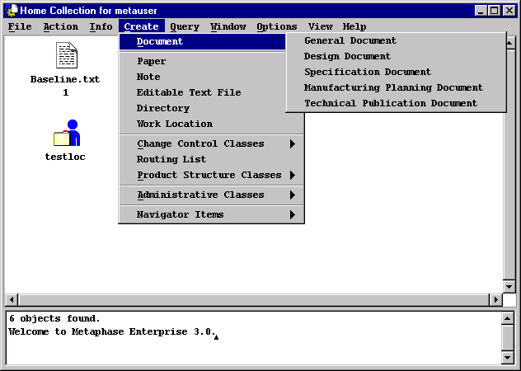
Business Item
  Documents
  Users will see on the Create and Query menus a submenu containing the five types of Documents.

Slide 22
2.3 Data Items
  Data Items represent the physical data that describe a product. This data consists of items such as
  design specifications created within a word processing application
  drawings generated on a CAD system
  test results in spreadsheets
  marketing collateral in hard-copy format
  Data Items are usually created by an application and have both a physical and a Metaphase database representation.

Slide 23

Data Items
  Examples of OMF Data Items are shown below:
  Editable Text File
  Represents a file whose contents are editable ASCII text characters. An editable text file can be viewed or edited with many different tools on many different computer systems.
  Directory
  Represents the same concept as a directory on an operating system. Any action (e.g., move, copy, delete) applied to the directory affects all of the files and subdirectories contained within the directory
  Note
  Represents a “post-it” note concept which allows the user to provide comments which can then be attached to another object such as a document.

Slide 24


Data Items
  Aggregate
  An abstract concept which represents a group of simple computer files or directories that must be treated as a single unit. Because of the application that generated them, the file system items should not be accessed individually.
  Independent Binary File
  A simple computer file whose contents are known to be of a binary format that may be exchanged between various types of computer systems in a useful manner. A GIF file is an example of an independent binary file.
  OS Dependent Binary File
  A simple computer file whose contents are known to be of a binary format that may not be freely transferred among various types of computer systems in a useful manner. A compiled program is an example of an OS dependent binary file.

Slide 25

Data Items
  Non-Editable Text
  A text file which is not intended to be edited using normal text editing tools even though it could be viewed or edited. A PostScript file is an example of a non-editable text file.
  Report
  A text file that contains information about Metaphase objects and relationships.
  Paper
  Represents a hard-copy item in a file cabinet or on someone’s desk.

Slide 26


2.4 Work Locations
  Metaphase manages file system items such as files and directories that are owned by users in work locations. Each work location is associated with exactly one user.
  Users can have multiple work locations
  on different hosts
  on a single host to organize data by project, for example
Mywork
User
Penwork

Slide 27
2.5 Organizational Items
  Organizational Items are not product data, but are used by users to organize their work more efficiently.
  Examples of OMF organizational items are shown below.
  Collection
  Collections are used by users to organize items. They form a logical grouping of items of any type.
  Saved Query
  A Saved query is not a collection of objects, but rather the query selection criteria that retrieve a set of objects. Each time a Saved Query is opened, a query is executed and the objects returned from the query may be different because objects were added or deleted from the system.

Slide 28

Organizational Items
SortPref
ColumnPref
DbPref
DeletePref
MovePref
ExpandPref
  Saved Preference
  A Saved Preference contains a user’s preference for a particular aspect of metaphase behavior. Each time a user double-clicks on a Saved Preference, the preference is applied to the current session. There are different preference types for different types of behaviors.

Slide 29


2.6 Tools
  Tools help users create product data from within Metaphase. They also help users use Metaphase more efficiently.
  The tools shown below are provided with OMF. Application interfaces and customizations typically include the addition of tools to Metaphase.
  vi Editor
  A UNIX text editing tool.
  Online Manual
  The Dynatext utility which has online versions of the Metaphase manuals.

Slide 30


2.7 Summary
How does Metaphase store user data?
metauser
Work Location
METAPART
Directory
CASING.DWG
CASING

Slide 31
Chapter 3
User Interaction with Metaphase

Slide 32
3.0 User Interaction with Metaphase
3.1 Starting a Metaphase Session
3.2 Browser
3.3 Dialog Windows
3.4 Usage Overview
3.4.1 Pulldown Menus
3.4.2 Mouse Usage

Slide 33
3.1 Starting a Metaphase Session
  The omf command launches a Metaphase session. The following options may be specified
  omf - starts Metaphase with no options
  omf -u <user name> - starts Metaphase as the specified user
    Example: omf -u Joe
  omf -b <browser font> - uses the specified browser font
    Example: omf -b large
  omf -d <dialog font> - uses the specified dialog box font
    Example: omf -d large
  omf -l <locale name> - uses the specified local language
    Example: omf -l en_us
  omf -h - prints out the entire help/usage message

Slide 34
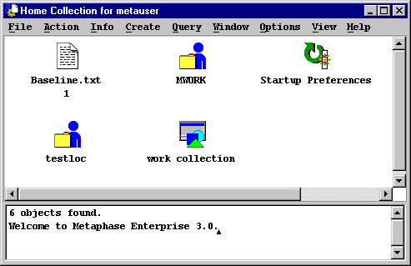
3.2 Browsers
  Browsers are used for viewing objects, navigating relationships, and initiating actions to manipulate objects and relationships.
Title
Menu Bar
Status Area
View Area

Slide 35
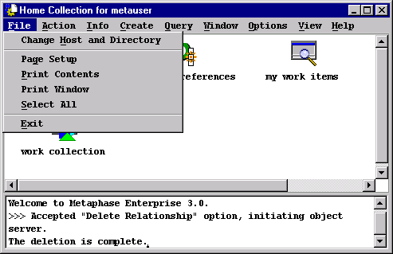
Browsers
  Home Collection
  First browser displayed to the user
  Items created in the Home Collection remain in the Home Collection for all subsequent sessions unless removed by the user
  File menu displays Exit

Slide 36

Browsers
  Home Collection
  The Home Collection contains default start-up objects for all users.
  Startup Preferences
  This is a special type of collection that is created the first time a user logs in. It is initially empty, but can be used to specify the preferences a user wishes to be applied to a session when it is started.
  my work items
  This is a saved query that is created the first time a user logs in. Opening this saved query returns all objects owned by that user.
  work collection
  This is initially an empty collection that is created the first time a user logs in. It can be used to organize a user’s current work items.

Slide 37
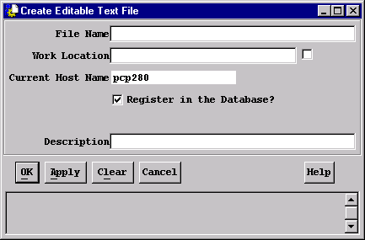
3.3 Dialog Windows
  Dialog Windows
  A window or form that is shown to the user, typically to either display detailed output or gather detailed input.
  The following dialog window is displayed when a user wants to create
  an editable text file:

Slide 38
Dialog Windows
  Common Buttons
  Executes the action and removes the dialog window.
  Executes the action and the dialog window remains open.
  Creates a Saved Query on query dialog windows or a Saved Preference on a preference dialog window.
  Refills the dialog with the last selections executed or saved entered.
  Clears the contents of every editable field.
  Exits the dialog without completing the action.
  Gives descriptive information about the current dialog window.
OK
Apply
Save...
Recall
Clear
Cancel
Help

Slide 39
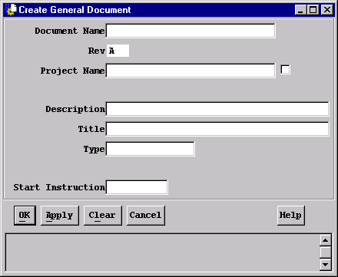
Dialog Windows
  Dialog window entry fields have list buttons when multiple choices are available
  If a button label has an underlined character, pressing the Alt (or meta) key along with the underlined character activates the button
List
Button

Slide 40
Dialog Windows
  To cut and paste into a Dialog Window:
  Non-UNIX host:
    Select the text you wish to copy using the mouse
    From the keyboard depress Ctrl-C to copy or Ctrl-X to cut
    Move the pointer to desired dialog field and depress Ctrl-V
  UNIX hosts:
    Select the text you wish to copy using the mouse
    Move pointer to desired dialog field and depress the middle mouse button

Slide 41

3.4 Usage Overview
  A typical browser has the following menus:
  menus are activated by depressing the left mouse button on the menu desired
  mnemonics allow quick access to the menus without use of a mouse
    To display a menu, press the Alt (or meta) key and the underlined character
    To choose an option from the menu, press the option’s underlined character

Slide 42
3.4.1 Pulldown Menus
  The options displayed on each menu depend upon:
  The application modules that are installed
  For example, the LCM Work List option only appears on the Window pulldown menu if the Life Cycle Manager module is installed
  The rules for the user
  Rules can be written so that a given user may only view objects; therefore, the Edit option is not displayed for that user.
  Some options may be “grayed-out” depending upon:
  The type of object selected
  This is most specifically for the Action menu. For example, collections cannot be copied. Therefore, selecting a collection and displaying the Action menu shows Copy as gray-shaded. This means the user cannot perform this action.

Slide 43
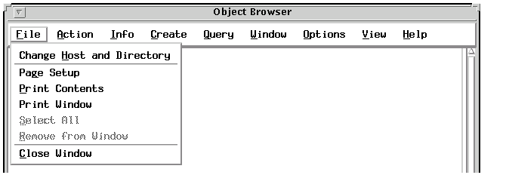
Pulldown Menus
  File Menu
  Change Host and Directory allows a user to specify the host and directory where file system operations will occur
  Page Setup sets printing values such as paper size and orientation
  Print Contents prints the entire contents of a window
  Print Window prints the visible portion of a window
  Select All selects each item in the browser
  Remove From Window removes the selected object(s) from the browser
  Close Window closes the current browser

Slide 44
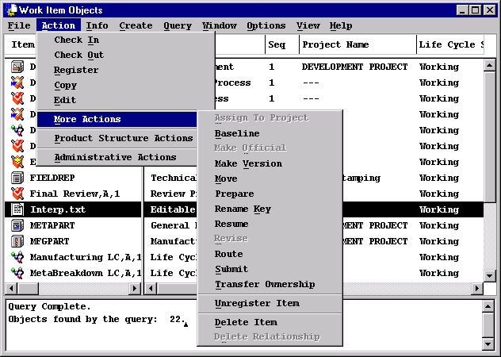
Pulldown Menus
  Action Menu
  the Action menu displays options which manipulate metaphase data

Slide 45
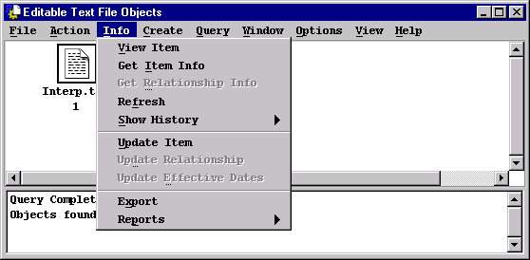
Pulldown Menus
  Info Menu
  the Info menu displays options which allow a user to display or update information about data managed by Metaphase

Slide 46
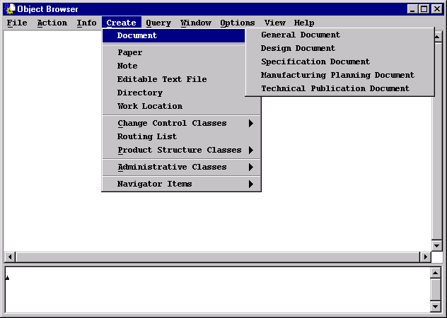
Pulldown Menus
  Create Menu
  the Create menu displays the types of data a user can create in Metaphase

Slide 47
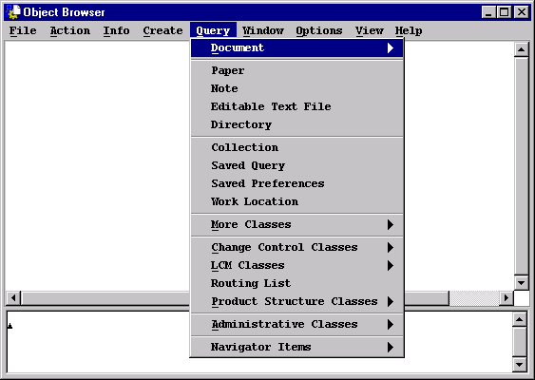
Pulldown Menus
  Query Menu
  the Query menu allows a user to locate different types of information stored in the system. These queries present a dialog window to further define the selection criteria.

Slide 48
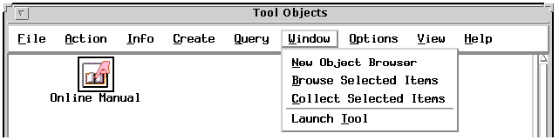
Pulldown Menus
  Window Menu
  A New Object Browser is an empty browser. Open one when you do not want to create items and have them remain in the Home Collection
  Choosing Browse Selected Items opens a new browser containing only the selected items. Use this option to work with a smaller number of items than are displayed in the current browser
  Choosing Collect Selected Items creates a new collection containing the selected objects
  Launch Tool allows a user to specify options in a dialog box before launching a selected tool

Slide 49
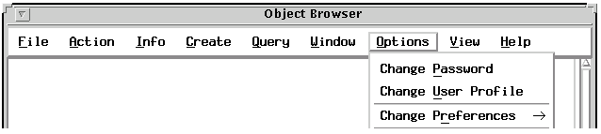
Pulldown Menus
  Options Menu
  Change password allows a user to change his/her Metaphase password
  Change User Profile allows a user to change personal information, Email address, and whether the user accepts objects transferred from other users or vaults
  Change Preferences allows a user to change preferences for the current session and create saved preferences. The OMF preferences are:
    Database
    Item Delete
    Item Movement
    Expansion Level

Slide 50
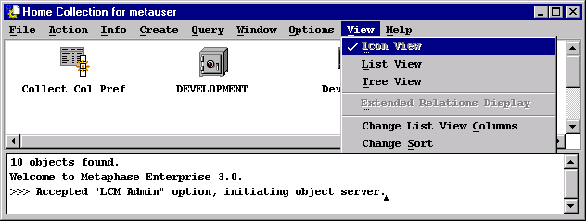
Pulldown Menus
  View Menu
  The View menu allows a user to change:
  the displayed view
  browser preferences

Slide 51
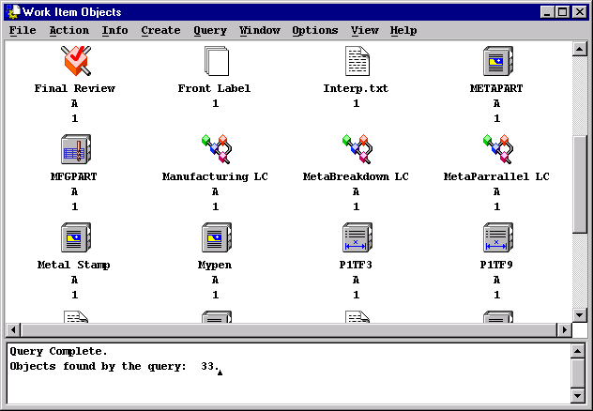
Pulldown Menus
  View Menu
  Icon View displays large icons, which makes specific objects easier to locate and to drag and drop onto other icons

Slide 52
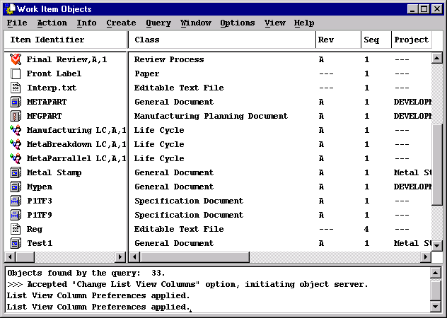
Pulldown Menus
  View Menu
  List View displays detailed information about each object including its relationships

Slide 53
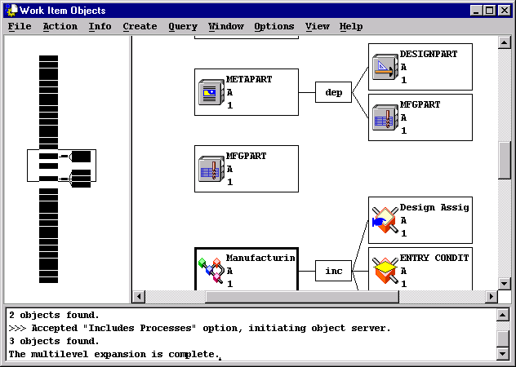
Pulldown Menus
  View Menu
  Tree View is used to graphically navigate relationships
  The left side of the window displays an overall view of all objects

Slide 54
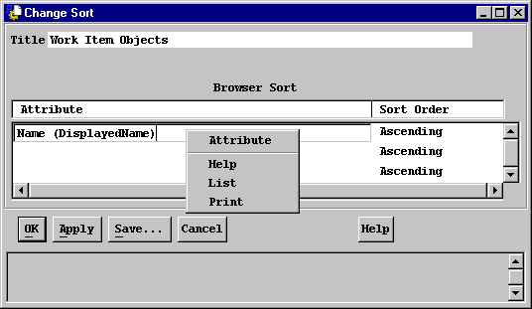
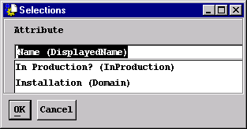
Pulldown Menus
  View Menu
  Change List View Columns allows a user to specify the attributes and column widths for the column headings in the list view browser
  The settings may be applied to the current browser or saved for future use
  Column titles can be changed by entering new strings in the lower bar.
  Columns can be added, removed, or replaced by following the options in the popup for each column.
  Click OK to apply or Save… to save and name this preference.

Slide 55
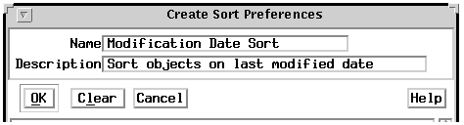
Pulldown Menus
  User Preferences - Summary
  A Preference object is created and named via the Save… buttons; this does not apply the preference.
  A Saved Preference can be subsequently modified by selecting it and choosing Action ---> Edit.
  A Preference can be applied from the previous dialog, which does not save it as an object.
  A Saved Preference stored in the Startup Preferences collection is applied at start-up.
  The Startup Preferences collection can be moved or deleted; if deleted, it is recreated at next start-up.
  A Saved Preference (in a browser) can be applied by double-clicking it.
  Keeping saved preferences in a collection makes them easily accessible.

Slide 56
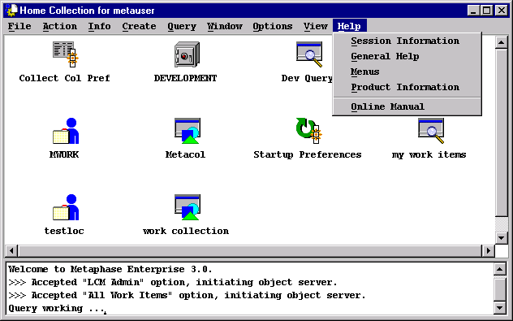
Pulldown Menus
  Help Menu
  Provides Help to the user in various categories.

Slide 57
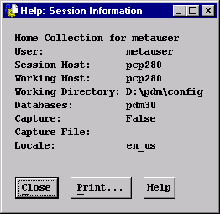
Pulldown Menus
  Help Menu
  Session Information displays information about the user and host which launched the Metaphase product.

Slide 58
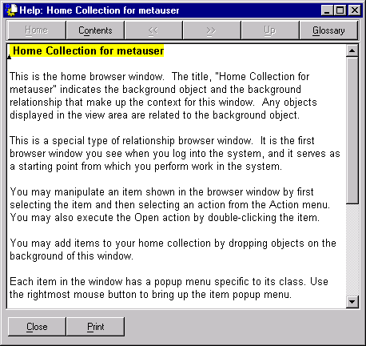
Pulldown Menus
  Help Menu
  General Help displays information about the current browser window.

Slide 59
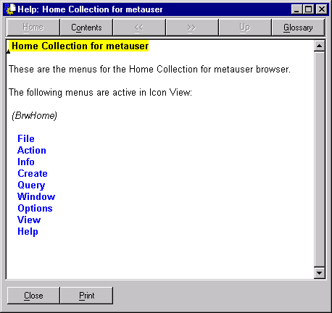
Pulldown Menus
  Help Menu
  Menus displays information about the menus on the current browser window.

Slide 60
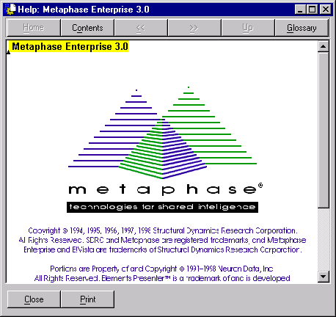
Pulldown Menus
  Help Menu
  Product Information displays the Metaphase version number and copyright information.

Slide 61
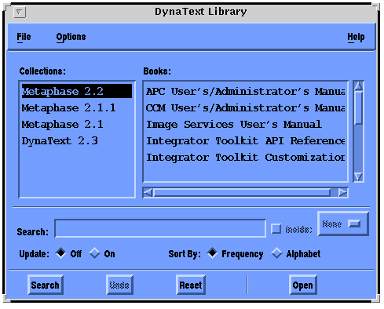
Pulldown Menus
  Help Menu
  Online Manual allows a user to search any manual for a specified topic.

Slide 62
3.4.2 Mouse Usage
  Unix Environment
  Left Button
    (Left-) Click deselects all, then selects one object.
    Double-Click or Right-Click deselects all, then selects one object.
    Shift-Click to select the “other end” of a contiguous range.
    Ctrl-Click to add or remove single objects to/from the range.
    Click in the right panel in list view to deselect all.
    Icon drop does not deselect existing selections.
    Click-Drag selects and drags in one operation.
    Click-Drag in the left panel of a tree view browser changes the items displayed in the right panel.
  Middle Button
    Displays the current Metaphase window.
    Allows the user to bring a selected window to the front.
  Right Button
    Displays the Object identifier.
    Allows the user to Get Item Info about an object.
    Allows the user to Refresh the selected object.
    Allows the user to edit and view relationships to an object.

Slide 63
Mouse Usage
  PC Environment
  Middle button functions are activated by pushing down the left and right buttons simultaneously.
  Macintosh Environment
  Left button functions are activated with the mouse button.
  Middle button function is activated by depressing the Command key followed by the mouse button
  Right button functions are activated by depressing the Option key followed by the mouse button

Slide 64
Chapter 4
Populating the Metaphase System with Information

Slide 65
4.0 Populating Metaphase with Information
4.1 Information: What is it?
4.2 How does information get into the system?
4.2.1 Creating Work Locations
4.2.2 Creating Data
4.2.3 Registering and Unregistering data
4.2.4 Application Interfaces

Slide 66
4.1 Information: What is it?
  Metaphase manages all product data such as
  Part Information
  Process Plans
  Printed documents
  Electronic CAD drawings and models
  Design Engineering Specifications
  Manufacturing Specifications
  Technical Publications
  Configuration Management Information
  Bill of Material & Parts Lists
  ECPs (Engineering Change Proposals)

Slide 67



4.2 How Does Information get into the system?
DATABASE
\\users\pdm\work1\dwg
Business Items are purely metadata
/usr/pdm/work/design
Data Items consist of both
metadata and physical data
/usr/pdm/work/analysis
Offline Items

Slide 68
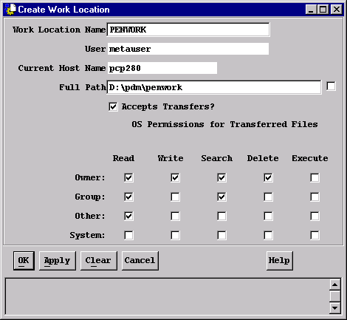
4.2.1 Creating Work Locations
  Metaphase uses work locations to store online items such as files and directories that are owned by users.
  To create a new Work Location choose Create ---> Work Location

Slide 69
Creating Work Locations
  Tips on Creating Work Locations
  The Work Location Name can be any name which is unique for the user
  The Full Path of the work location must be a sub-directory of a user’s home or of the root directory
  If Accept Transfers is selected, other users may be allowed to transfer file system items to this work location
  The OS Permissions for Transferred Files specify the permissions applied to files copied, moved, or transferred to this work location. Not all permissions apply to all platforms
  If the specified directory already exists, Metaphase registers it; if it does not exist, Metaphase creates that directory
  Once the work location is created, a user may access it from the host where it was created and from any other hosts that are members of the same host group as the original host

Slide 70


4.2.2 Creating Data
The following suggests 2 possible ways to Create data using OMF:
1
Create Document
via OMF
Automatically
Stored
Marketing
Marketing Analysis
Database
Stored in a
Department
File Cabinet
2
Create Paper
via OMF
Automatically
Stored
Marketing Analysis
Database

Slide 71
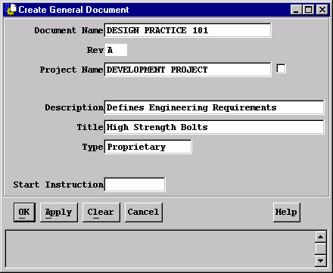
Creating Data
  The following steps occur when a user creates data:
  Step 1 --> Present Dialog to user to gather information
  This step allows the user to add the proper data descriptions.
  The attributes displayed in these dialogs will vary based on the type of data created.

Slide 72
Creating Data
  Step 2 --> Store the information about the data in the database
Database

Slide 73
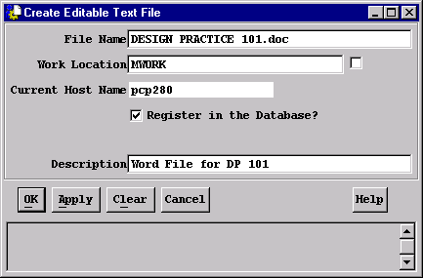
Creating Data
  Step 3 --> Create the actual data in the case of file system data
  Only Data Items exist as bulk data on a file system.

Slide 74
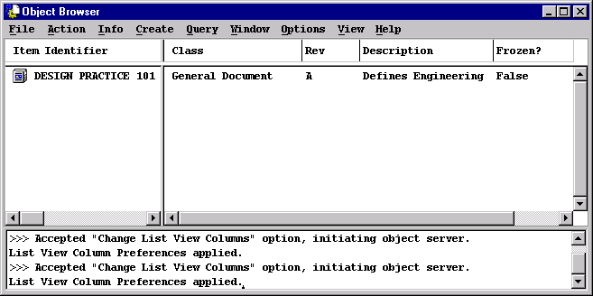
Creating Data
  Step 4 --> Display the user’s data in the current browser window

Slide 75
Creating Data
Creating and registering data makes the user the owner of the data
Ray
creates
owned by
Work Location
for Ray
Ray
DP 101

Slide 76

Creating Data
A file system item created by a user is owned by that user and is mapped to a physical directory called a work location.
Each user may have multiple work locations for bulk data. Only file system items are mapped to work locations.
Ray
creates
located in
Work Location
for Ray
DP 101.doc
Ray
DP 101.doc

Slide 77
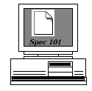

4.2.3 Registering Data
Information may already exist electronically
Stored in a
Work Location
on a PC
Marketing
Query Work Location
via OMF
Select Text File
Choose Register
via Action Menu
Spec 101
Work Location
Spec 101
Database
Registering data allows it to be managed by Metaphase

Slide 78
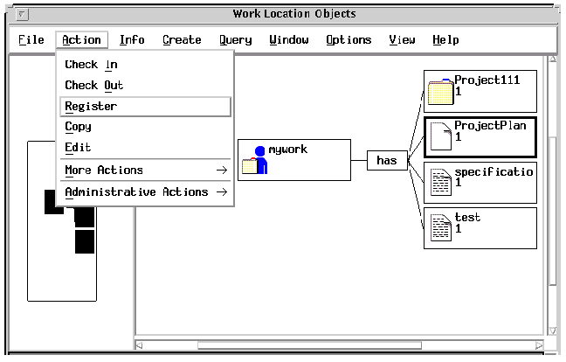
Registering Data

Slide 79
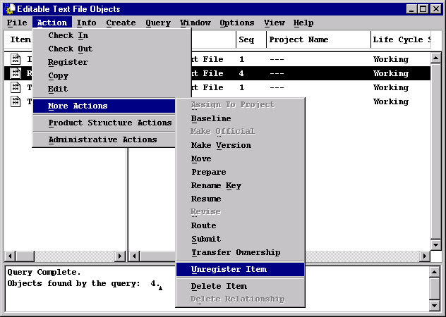
Unregister Action
It is possible to remove a File System item (File or Directory) from the Metaphase database, without deleting it from disk, by selecting the item and choosing:

Slide 80

4.2.4Application Interfaces
Many applications create and register additional information for the user
Engineering
User logs in as Jim
on a Unix Workstation
Jim
Selects Create
“CADdrawing”
via OMF
Application is launched
and Jim creates drawing
Jim exits CAD
drawing and
the metadata
is stored in
the database
6.5
15
Database

Slide 81
Chapter 5
Locating Information

Slide 82
5.0 Locating Information
5.1 Introduction
5.2 Query Menu
5.3 Navigation

Slide 83
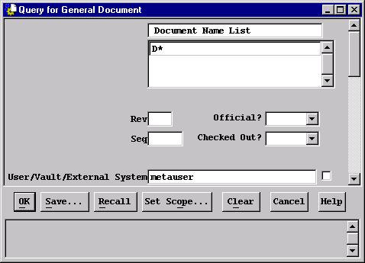
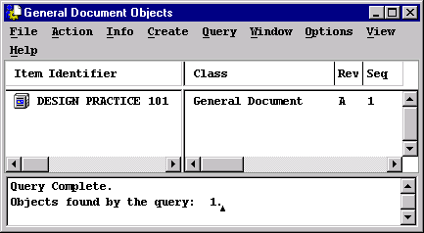
5.1 Introduction
Database
Dialog Window
Browser Window

Slide 84
Introduction
  The items displayed to any user locating data depend on the following:
  access to objects as determined by rules
  the user’s database scope
  the application modules that are installed

Slide 85
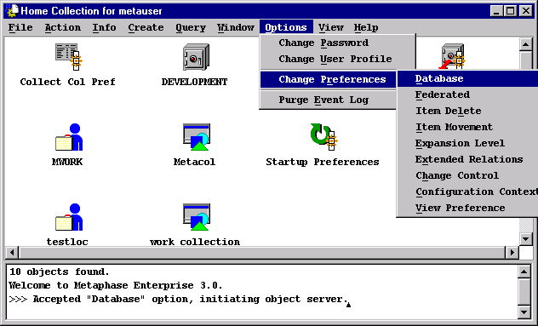
Introduction
  Items are retrieved from the database in the user’s current scope
  A user’s scope is usually the local user database
  The scope can be changed through the Database preference

Slide 86
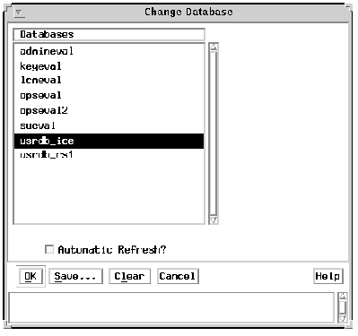

Introduction
  Selecting the desired database(s) and pressing OK applies the database preference to all future queries
  Pressing Save… creates a Saved Preference which can be applied to future sessions.

Slide 87
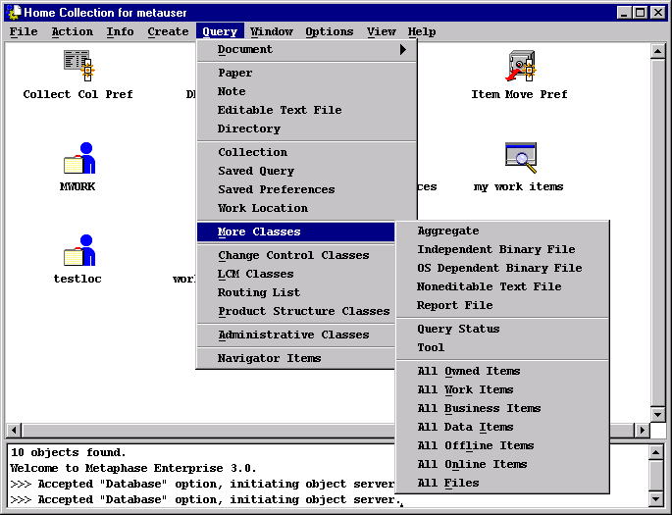
5.2 Query Menu

Slide 88

Query Menu
  Pulldown displays all items that rules allow the user to query
  Pulldown is dependent on Application Modules that are installed, including customizations
  More Classes --> allows the user to span the criteria across classes
  A dialog is always presented to further the selection criteria
  Pressing Save… on a query dialog allows the user to Save the query for quick access of frequent queries. The results of this saved query may change if the objects and/or their attributes change. The saved query icon will be displayed in the Home Collection for the user.
  A query browser is displayed presenting the resulting objects
  Users may stop large queries before they complete by pressing the Stop button on the progress window.

Slide 89

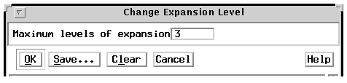
5.3 Navigation
Navigation allows the user to locate objects through relationships using list view or tree view
Navigating relationships is accomplished by:
1. Selecting the object
2. Depressing the right mouse button
3. Choosing Expand Relationship or Expand Multiple Levels
4. Choosing the desired relationship
If Expand Multiple Levels is chosen, the number of levels in the expansion can be changed through the Expansion Level preference.

Slide 90
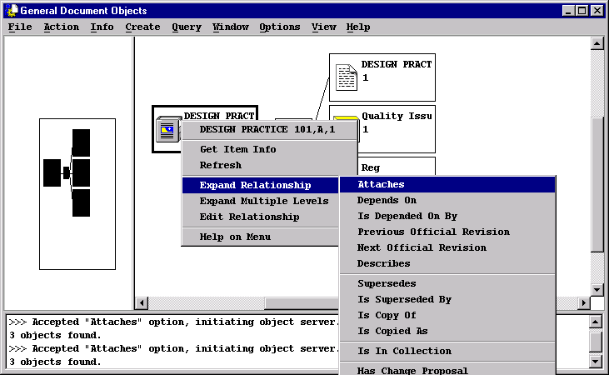
Navigation

